Slide 1

DATA STRUCTURES AND ALGORITHMS (113215)
Dr. Owais Hussain

Slide 2

Agenda
Search
Search in Unordered Data
Search in Ordered Data
Binary Search
Optimization
Complexity Analysis

Slide 3
Sample 2
Search
Search is one of the most frequently used functions in computers.
“Any algorithm which solves the search problem, namely, to retrieve information stored within some data structure, or calculated in the search space of a problem domain, either with discrete or continuous values”. [Wikipedia]
It is a step-by-step method to find one or more data points in a collection of data.
Different data structures employ different strategies for search.
There are two types of search algorithms: Linear and Binary search
Linear search is applicable on any type of data, while binary search requires the data to be already sorted.

Slide 4
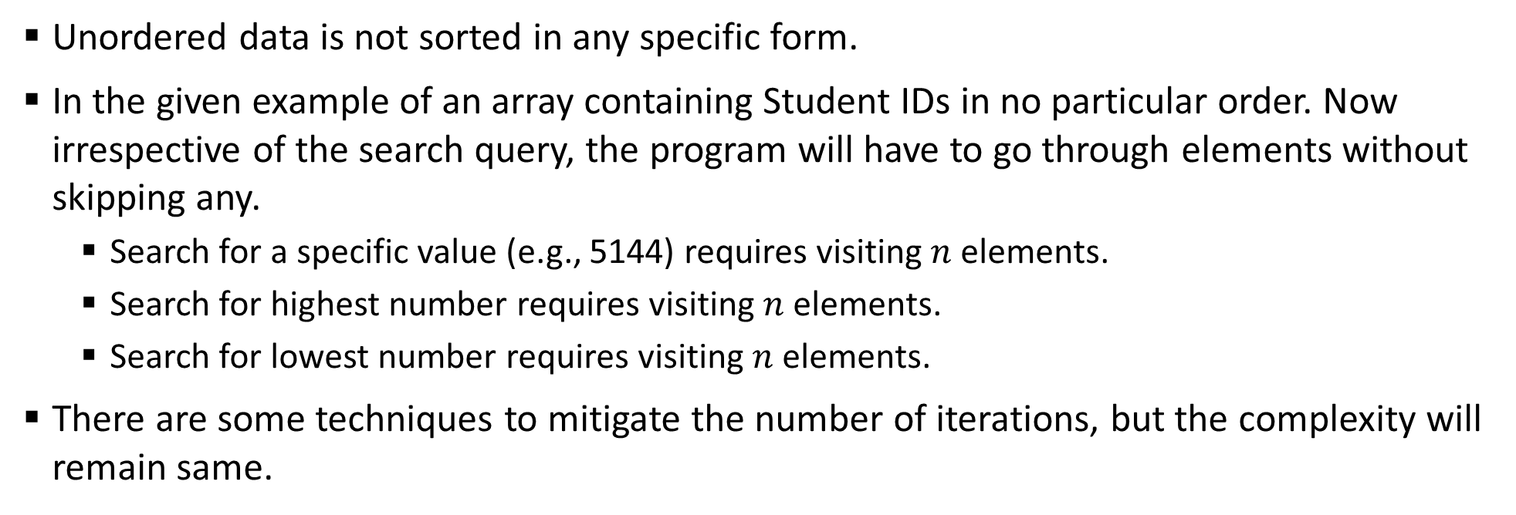
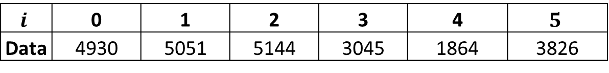
Sample 2
Search in Unordered data
Unordered data is not sorted in any specific form.
In the given example of an array containing Student IDs in no particular order. Now irrespective of the search query, the program will have to go through elements without skipping any.
Search for a specific value (e.g., 5144) requires visiting $n$ elements.
Search for highest number requires visiting $n$ elements.
Search for lowest number requires visiting $n$ elements.
There are some techniques to mitigate the number of iterations, but the complexity will remain same.
$$i$$ | 0 | 1 | 2 | 3 | 4 | $$5$$
Data | 4930 | 5051 | 5144 | 3045 | 1864 | 3826

Slide 5
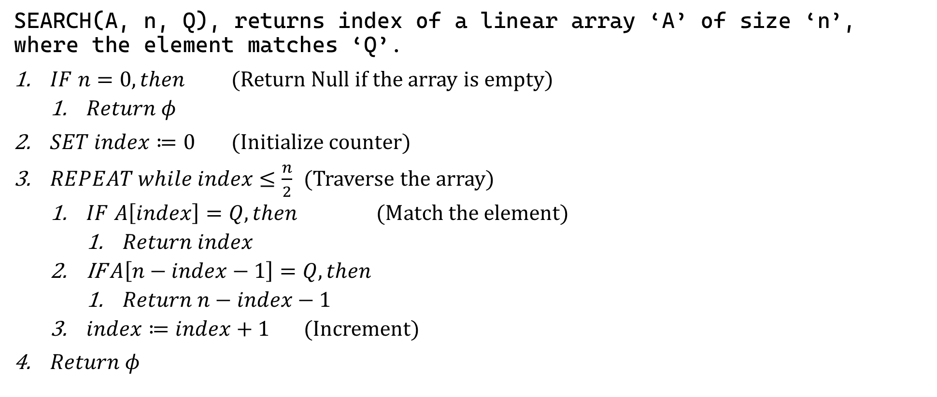
Sample 2
Search in Unordered data – A variation
SEARCH(A, n, Q), returns index of a linear array ‘A’ of size ‘n’, where the element matches ‘Q’.
$IF n=0, then$ (Return Null if the array is empty)
$Return φ$
$SET index≔0$ (Initialize counter)
$REPEAT while index≤\frac{n}{2}$ (Traverse the array)
$IF A\left[index\right]=Q, then$ (Match the element)
$Return index$
IF $A\left[n−index−1\right]=Q, then$
$Return n−index−1$
$index≔index+1$ (Increment)
$Return φ$

Slide 6
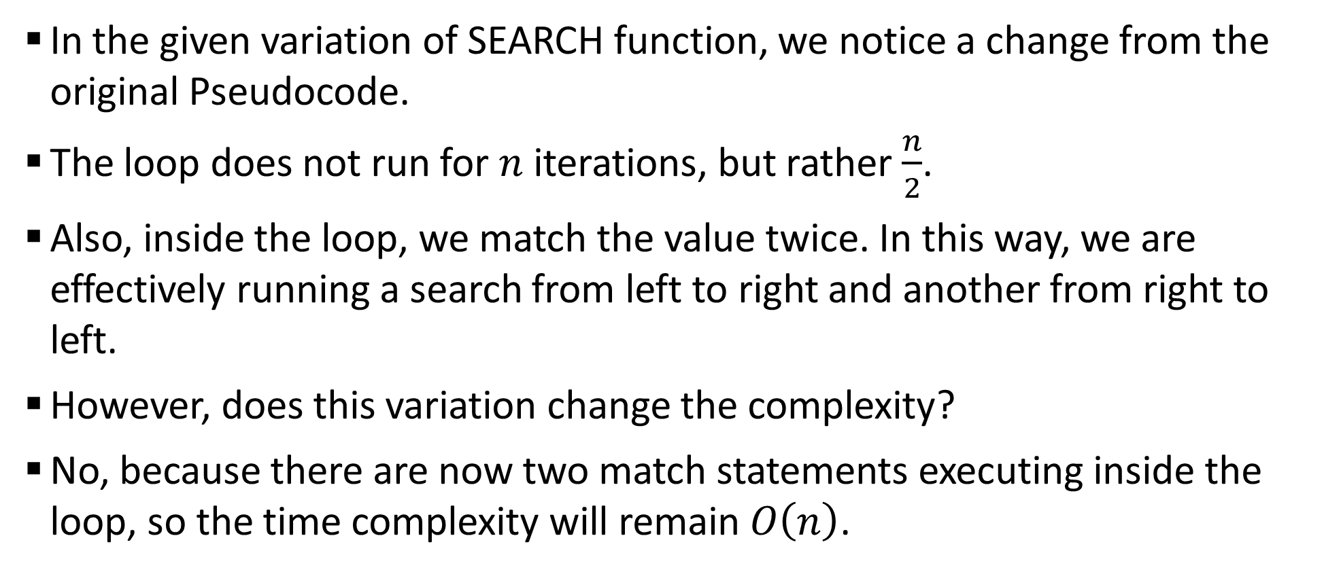
Sample 2
Search in Unordered data
In the given variation of SEARCH function, we notice a change from the original Pseudocode.
The loop does not run for $n$ iterations, but rather $\frac{n}{2}$.
Also, inside the loop, we match the value twice. In this way, we are effectively running a search from left to right and another from right to left.
However, does this variation change the complexity?
No, because there are now two match statements executing inside the loop, so the time complexity will remain $O\left(n\right)$.

Slide 7
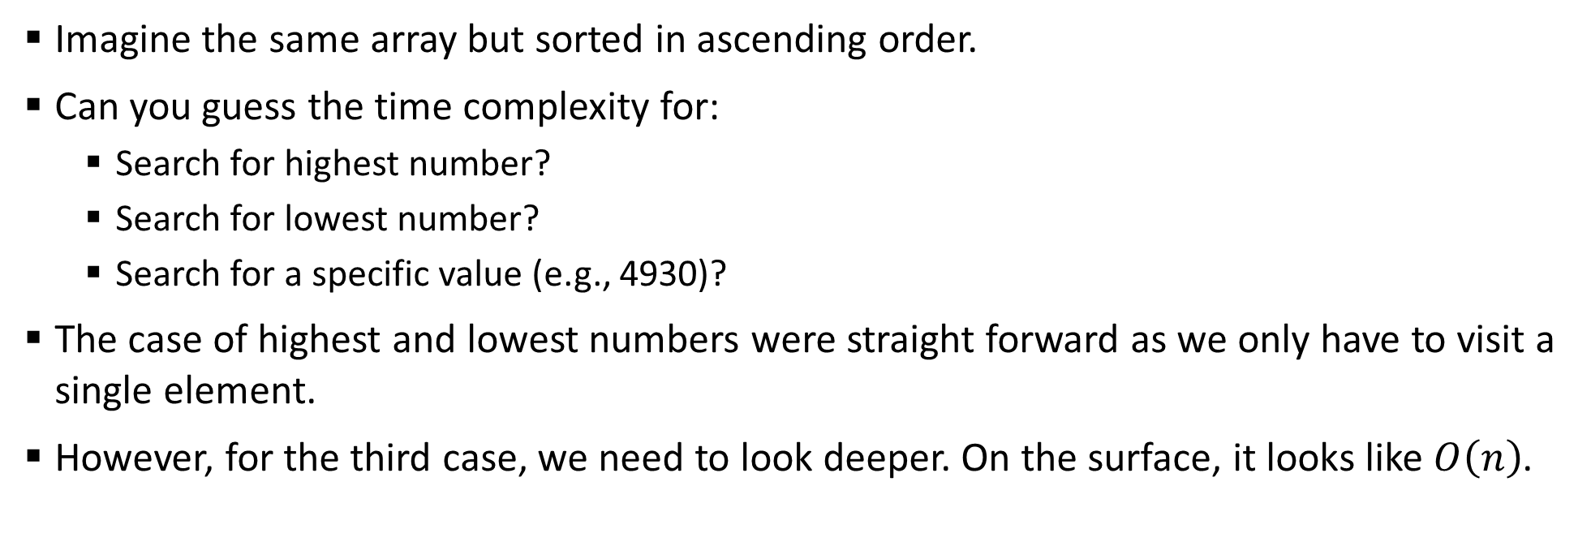
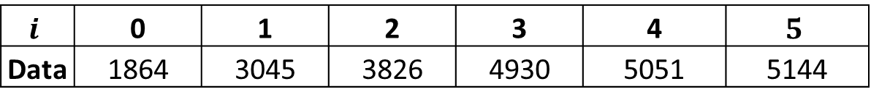
Sample 2
Search in Ordered data
Imagine the same array but sorted in ascending order.
Can you guess the time complexity for:
Search for highest number?
Search for lowest number?
Search for a specific value (e.g., 4930)?
The case of highest and lowest numbers were straight forward as we only have to visit a single element.
However, for the third case, we need to look deeper. On the surface, it looks like $O\left(n\right)$.
$$i$$ | 0 | 1 | 2 | 3 | 4 | $$5$$
Data | 1864 | 3045 | 3826 | 4930 | 5051 | 5144

Slide 8
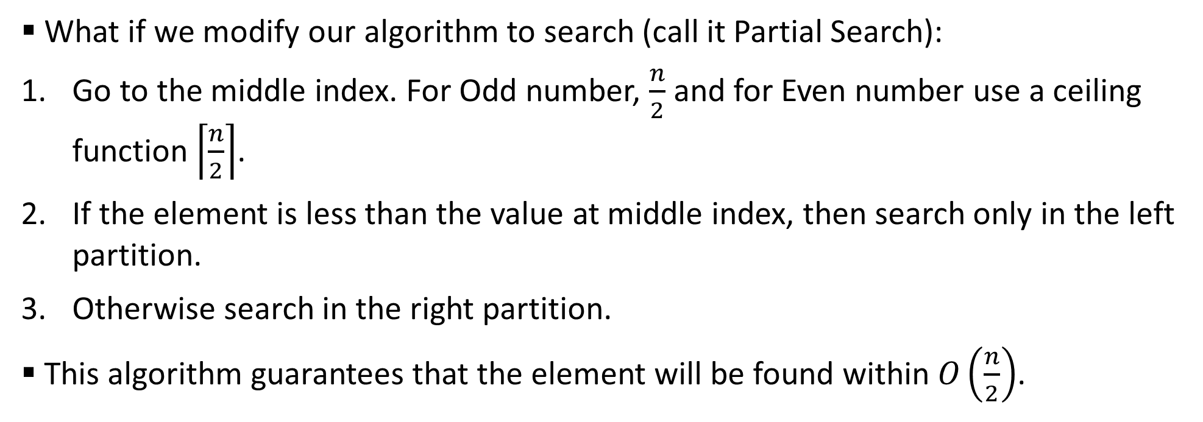
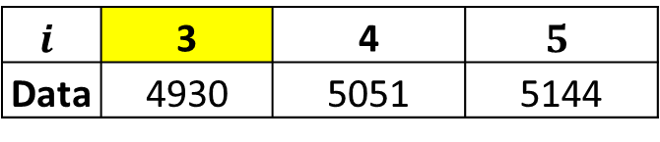
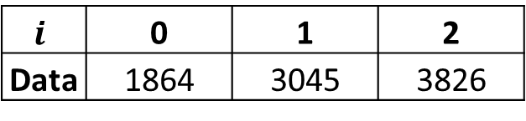
Sample 2
Search in Ordered data
What if we modify our algorithm to search (call it Partial Search):
Go to the middle index. For Odd number, $\frac{n}{2}$ and for Even number use a ceiling function $\left\lceil \frac{n}{2}\right\rceil$.
If the element is less than the value at middle index, then search only in the left partition.
Otherwise search in the right partition.
This algorithm guarantees that the element will be found within $O\left(\frac{n}{2}\right)$.
$$i$$ | 0 | 1 | 2
Data | 1864 | 3045 | 3826
$$i$$ | 3 | 4 | $$5$$
Data | 4930 | 5051 | 5144

Slide 9
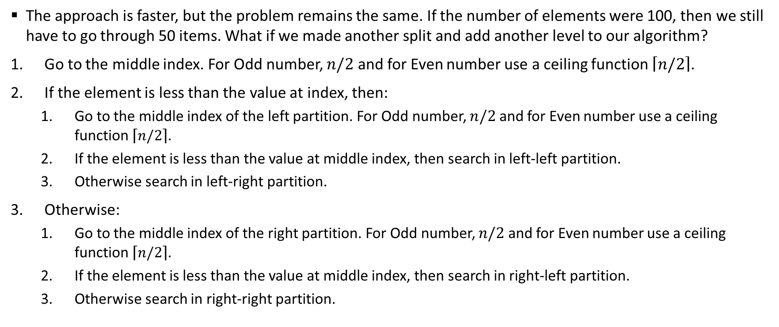
Sample 2
Search in Ordered data
The approach is faster, but the problem remains the same. If the number of elements were 100, then we still have to go through 50 items. What if we made another split and add another level to our algorithm?
Go to the middle index. For Odd number, $n/2$ and for Even number use a ceiling function $\left\lceil n/2\right\rceil$.
If the element is less than the value at index, then:
Go to the middle index of the left partition. For Odd number, $n/2$ and for Even number use a ceiling function $\left\lceil n/2\right\rceil$.
If the element is less than the value at middle index, then search in left-left partition.
Otherwise search in left-right partition.
Otherwise:
Go to the middle index of the right partition. For Odd number, $n/2$ and for Even number use a ceiling function $\left\lceil n/2\right\rceil$.
If the element is less than the value at middle index, then search in right-left partition.
Otherwise search in right-right partition.

Slide 10
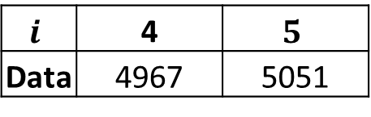
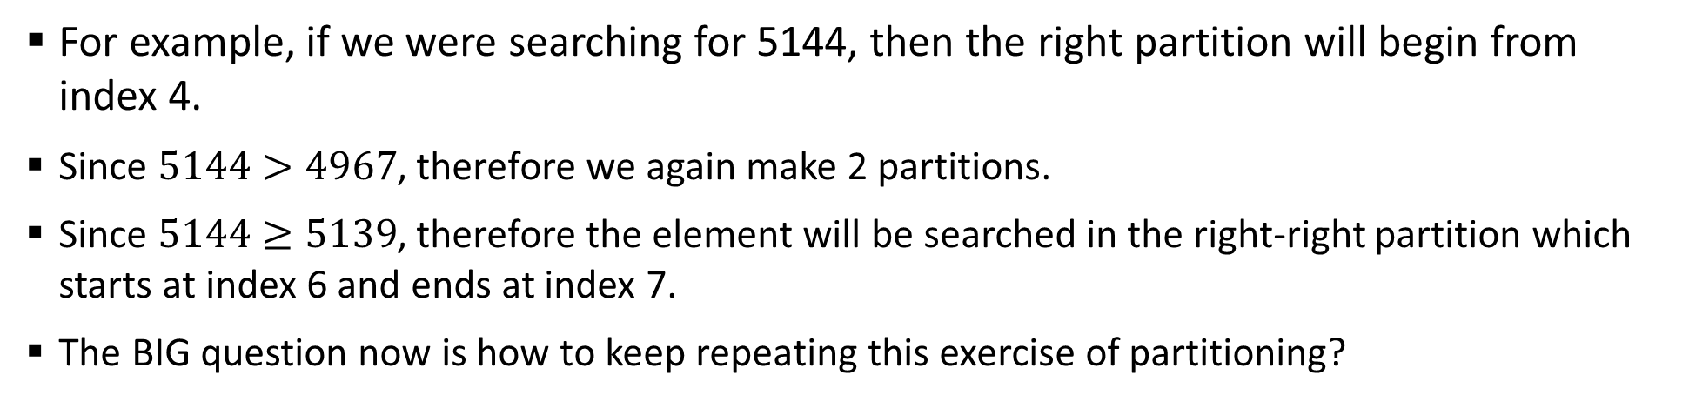
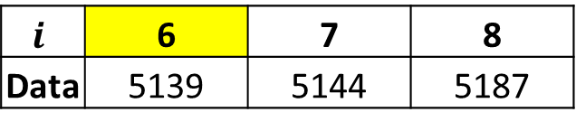
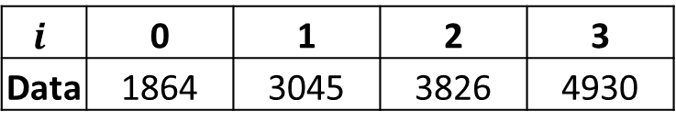
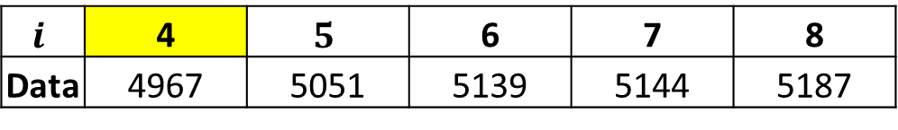
Sample 2
Search in Ordered data
For example, if we were searching for 5144, then the right partition will begin from index 4.
Since $5144>4967$, therefore we again make 2 partitions.
Since $5144≥5139$, therefore the element will be searched in the right-right partition which starts at index 6 and ends at index 7.
The BIG question now is how to keep repeating this exercise of partitioning?
$$i$$ | 0 | 1 | 2 | 3 | 4 | $$5$$ | 6 | 7 | 8
Data | 1864 | 3045 | 3826 | 4930 | 4967 | 5051 | 5139 | 5144 | 5187
$$i$$ | 0 | 1 | 2 | 3
Data | 1864 | 3045 | 3826 | 4930
$$i$$ | 4 | $$5$$ | 6 | 7 | 8
Data | 4967 | 5051 | 5139 | 5144 | 5187
$$i$$ | 4 | $$5$$
Data | 4967 | 5051
$$i$$ | 6 | 7 | 8
Data | 5139 | 5144 | 5187

Slide 11
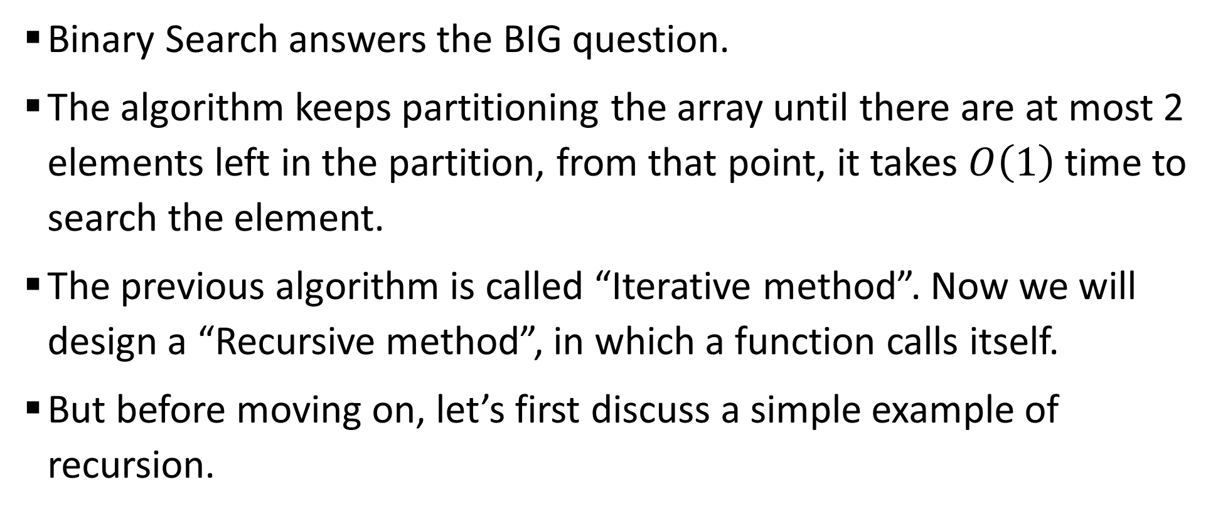
Sample 2
Binary Search
Binary Search answers the BIG question.
The algorithm keeps partitioning the array until there are at most 2 elements left in the partition, from that point, it takes $O\left(1\right)$ time to search the element.
The previous algorithm is called “Iterative method”. Now we will design a “Recursive method”, in which a function calls itself.
But before moving on, let’s first discuss a simple example of recursion.

Slide 12
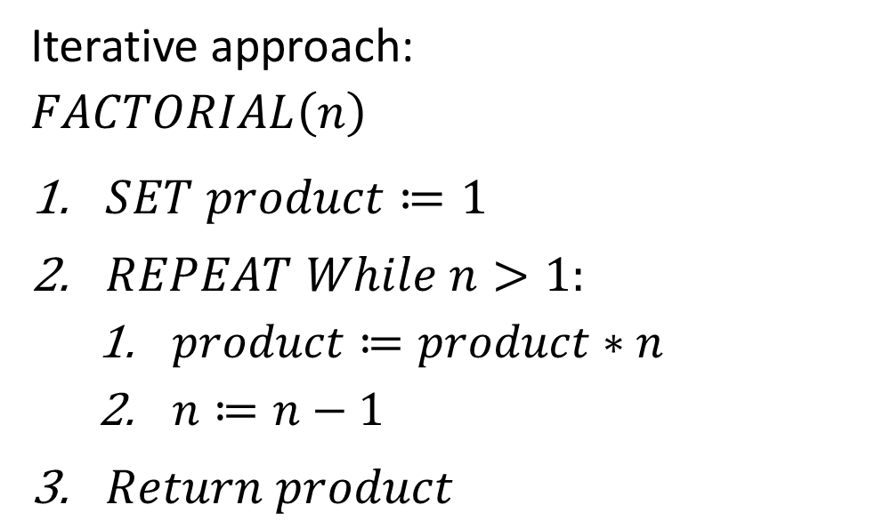
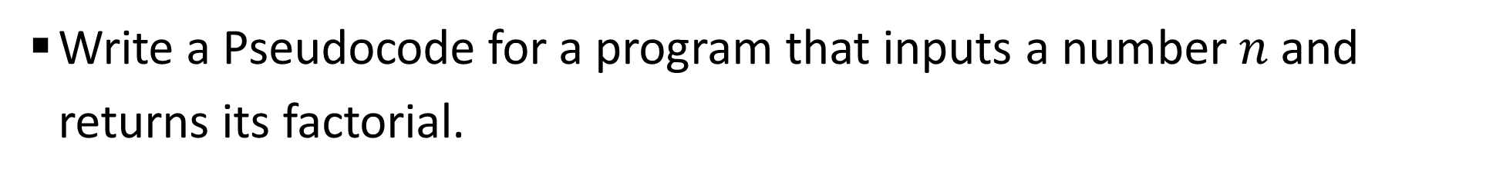
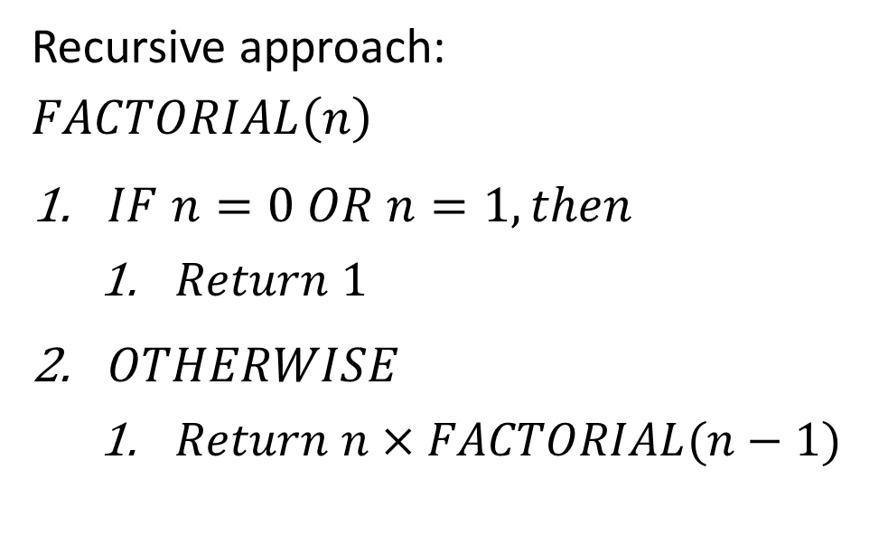
Sample 2
Binary Search
Write a Pseudocode for a program that inputs a number $n$ and returns its factorial.
Iterative approach:
$$FACTORIAL\left(n\right)$$
$SET product≔1$
$REPEAT While n>1:$
$product≔product∗n$
$n≔n−1$
$Return product$
Recursive approach:
$$FACTORIAL\left(n\right)$$
$IF n=0 OR n=1, then$
$Return 1$
$OTHERWISE$
$Return n×FACTORIAL(n−1)$

Slide 13
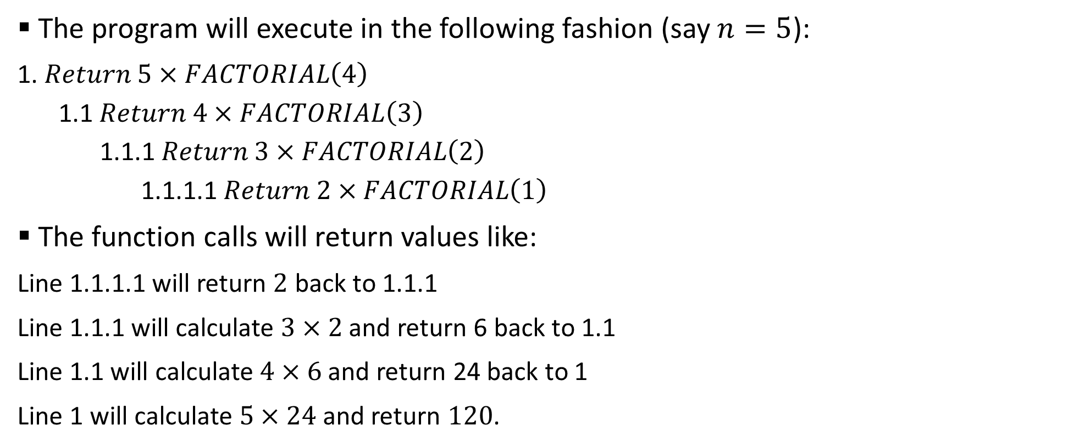
Sample 2
Binary Search
The program will execute in the following fashion (say $n=5$):
1. $Return 5×FACTORIAL\left(4\right)$
1.1 $Return 4×FACTORIAL\left(3\right)$
1.1.1 $Return 3×FACTORIAL\left(2\right)$
1.1.1.1 $Return 2×FACTORIAL\left(1\right)$
The function calls will return values like:
Line 1.1.1.1 will return $2$ back to 1.1.1
Line 1.1.1 will calculate $3×2$ and return 6 back to 1.1
Line 1.1 will calculate $4×6$ and return 24 back to 1
Line 1 will calculate $5×24$ and return $120$.

Slide 14
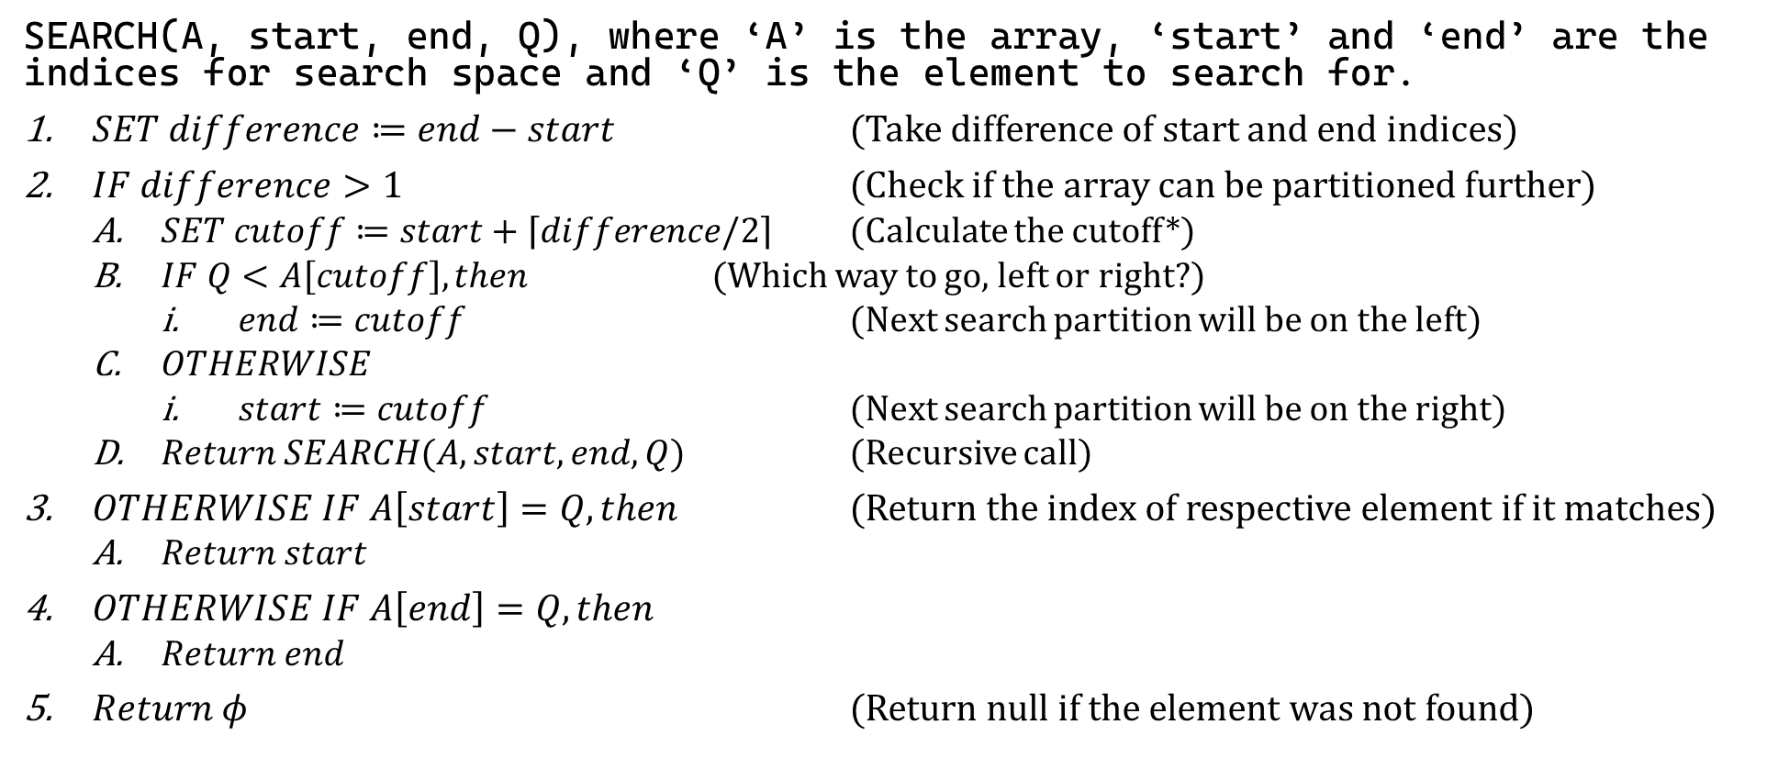
Sample 2
Binary Search
SEARCH(A, start, end, Q), where ‘A’ is the array, ‘start’ and ‘end’ are the indices for search space and ‘Q’ is the element to search for.
$SET difference≔end−start$ (Take difference of start and end indices)
$IF difference>1$ (Check if the array can be partitioned further)
$SET cutoff≔start+\left\lceil difference/2\right\rceil$ (Calculate the cutoff*)
$IF Q<A\left[cutoff\right], then$ (Which way to go, left or right?)
$end≔cutoff$ (Next search partition will be on the left)
$OTHERWISE$
$start≔cutoff$ (Next search partition will be on the right)
$Return SEARCH(A, start, end, Q)$ (Recursive call)
$OTHERWISE IF A\left[start\right]=Q, then$ (Return the index of respective element if it matches)
$Return start$
$OTHERWISE IF A\left[end\right]=Q, then$
$Return end$
$Return φ$ (Return null if the element was not found)
Notes:
The way we are calculating cutoff does not require checking for Even or Odd because we’re taking Ceiling of the quotient. Also note that we need to add “start” so that the indices are according to the Array.

Slide 15
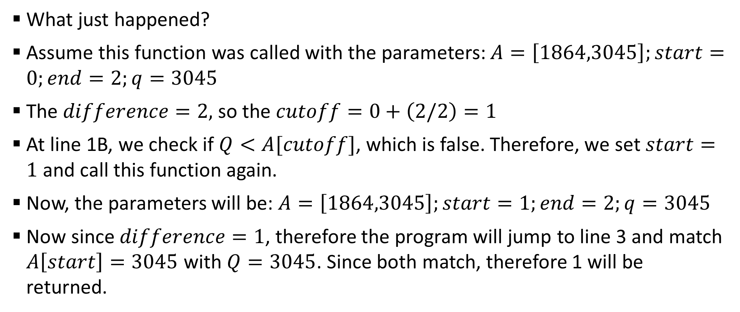
Sample 2
Binary Search
What just happened?
Assume this function was called with the parameters: $A=\left[1864,3045\right];start=0;end=2;q=3045$
The $difference=2,$ so the $cutoff=0+\left(2/2\right)=1$
At line 1B, we check if $Q<A[cutoff]$, which is false. Therefore, we set $start=1$ and call this function again.
Now, the parameters will be: $A=\left[1864,3045\right];start=1;end=2;q=3045$
Now since $difference=1$, therefore the program will jump to line 3 and match $A\left[start\right]=3045$ with $Q=3045$. Since both match, therefore 1 will be returned.

Slide 16
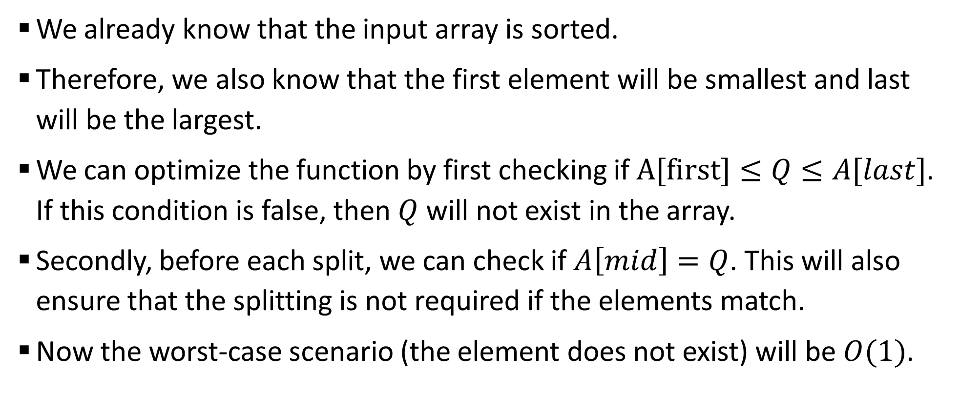
Sample 2
Optimization
We already know that the input array is sorted.
Therefore, we also know that the first element will be smallest and last will be the largest.
We can optimize the function by first checking if $A[first]≤Q≤A[last]$. If this condition is false, then $Q$ will not exist in the array.
Secondly, before each split, we can check if $A\left[mid\right]=Q$. This will also ensure that the splitting is not required if the elements match.
Now the worst-case scenario (the element does not exist) will be $O(1)$.

Slide 17
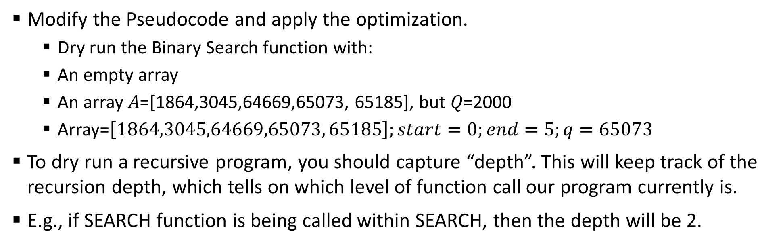
Sample 2
Exercise
Modify the Pseudocode and apply the optimization.
Dry run the Binary Search function with:
An empty array
An array 𝐴=[1864,3045,64669,65073, 65185], but 𝑄=2000
Array=$\left[1864,3045,64669,65073, 65185\right];start=0;end=5;q=65073$
To dry run a recursive program, you should capture “depth”. This will keep track of the recursion depth, which tells on which level of function call our program currently is.
E.g., if SEARCH function is being called within SEARCH, then the depth will be 2.
Depth | Line No. | Array | Start | End | Q | Difference | Cutoff
1 | 0 | [1864,3045,64669,65073,65185]

Slide 18
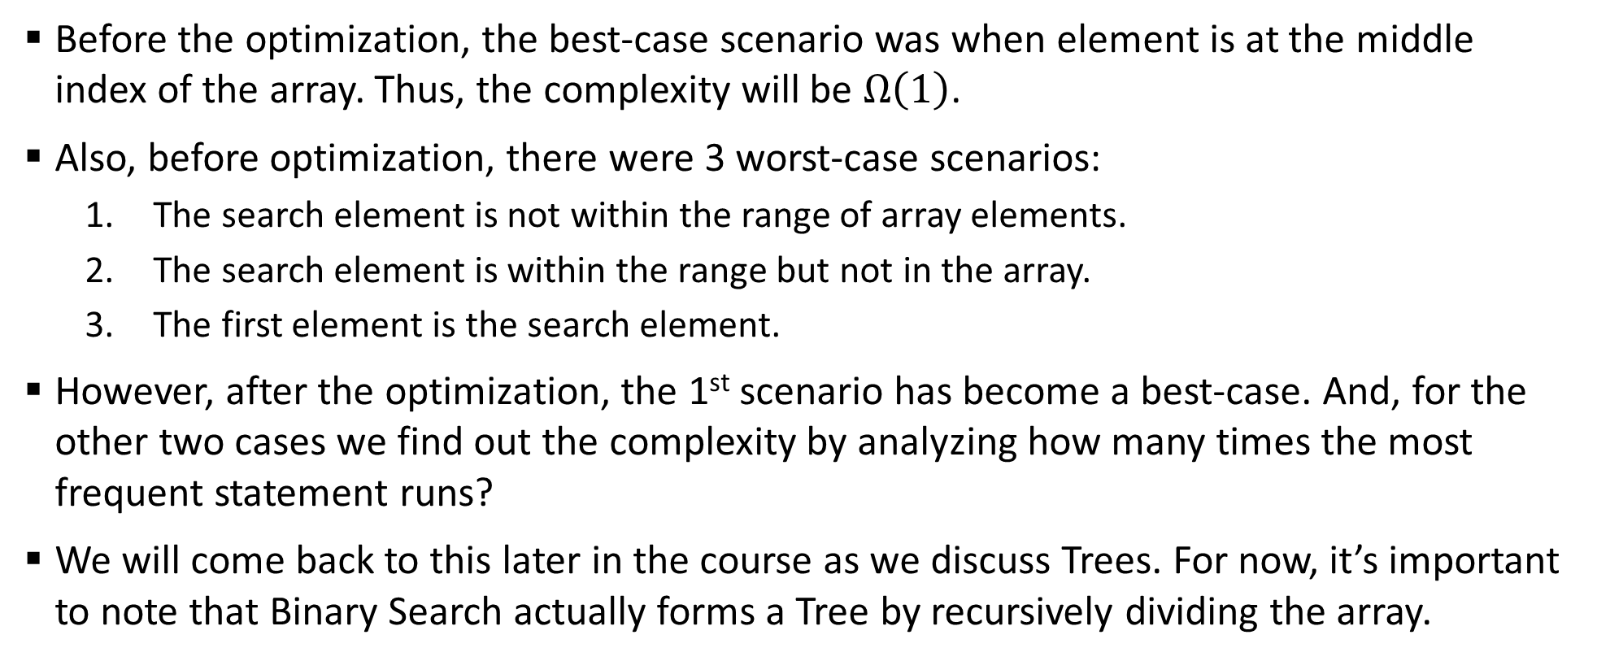
Sample 2
Complexity Analysis
Before the optimization, the best-case scenario was when element is at the middle index of the array. Thus, the complexity will be $Ω\left(1\right)$.
Also, before optimization, there were 3 worst-case scenarios:
The search element is not within the range of array elements.
The search element is within the range but not in the array.
The first element is the search element.
However, after the optimization, the 1st scenario has become a best-case. And, for the other two cases we find out the complexity by analyzing how many times the most frequent statement runs?
We will come back to this later in the course as we discuss Trees. For now, it’s important to note that Binary Search actually forms a Tree by recursively dividing the array.

Slide 19
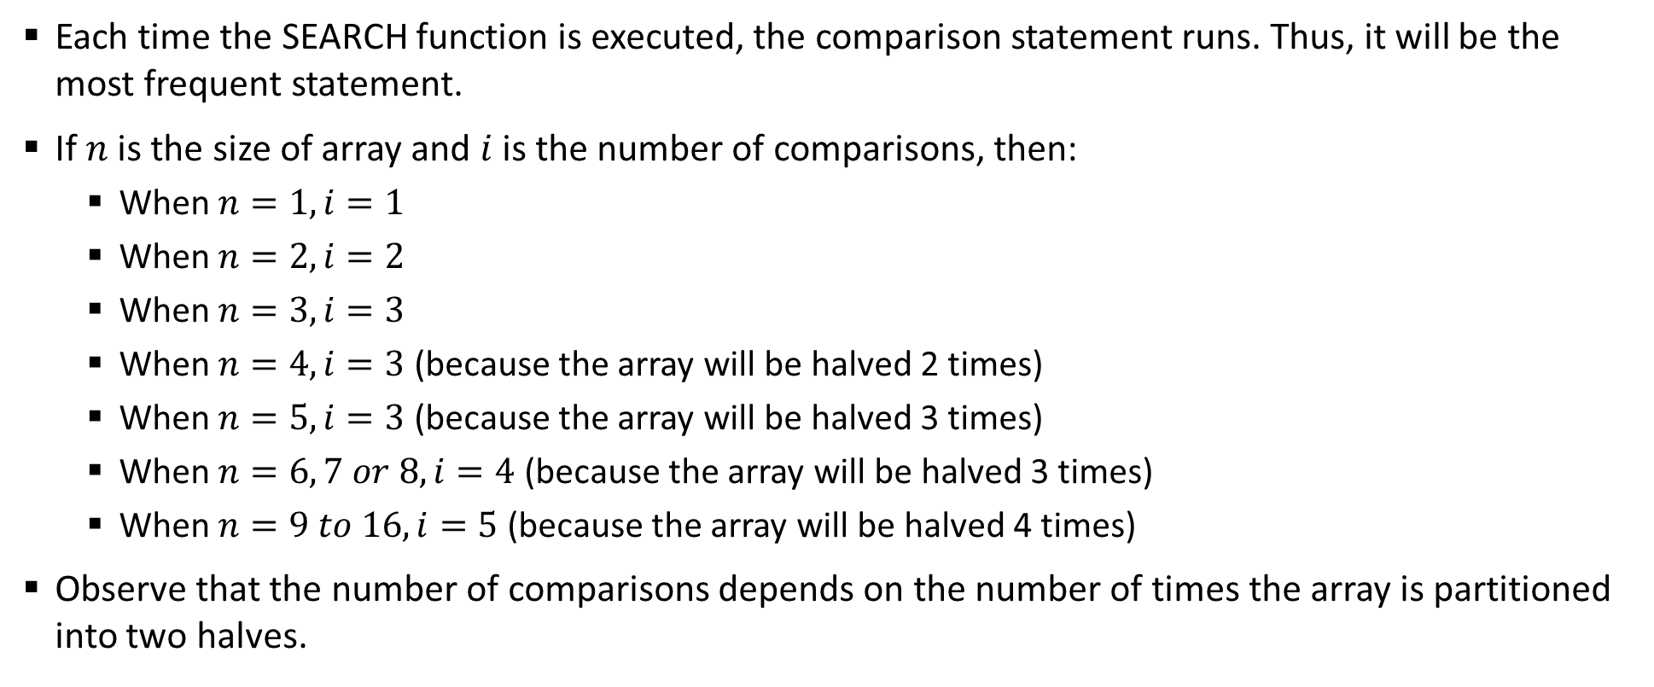
Sample 2
Complexity Analysis
Each time the SEARCH function is executed, the comparison statement runs. Thus, it will be the most frequent statement.
If $n$ is the size of array and $i$ is the number of comparisons, then:
When $n=1,i=1$
When $n=2,i=2$
When $n=3,i=3$
When $n=4,i=3$ (because the array will be halved 2 times)
When $n=5,i=3$ (because the array will be halved 3 times)
When $n=6, 7 or 8,i=4$ (because the array will be halved 3 times)
When $n=9 to 16,i=5$ (because the array will be halved 4 times)
Observe that the number of comparisons depends on the number of times the array is partitioned into two halves.

Slide 20
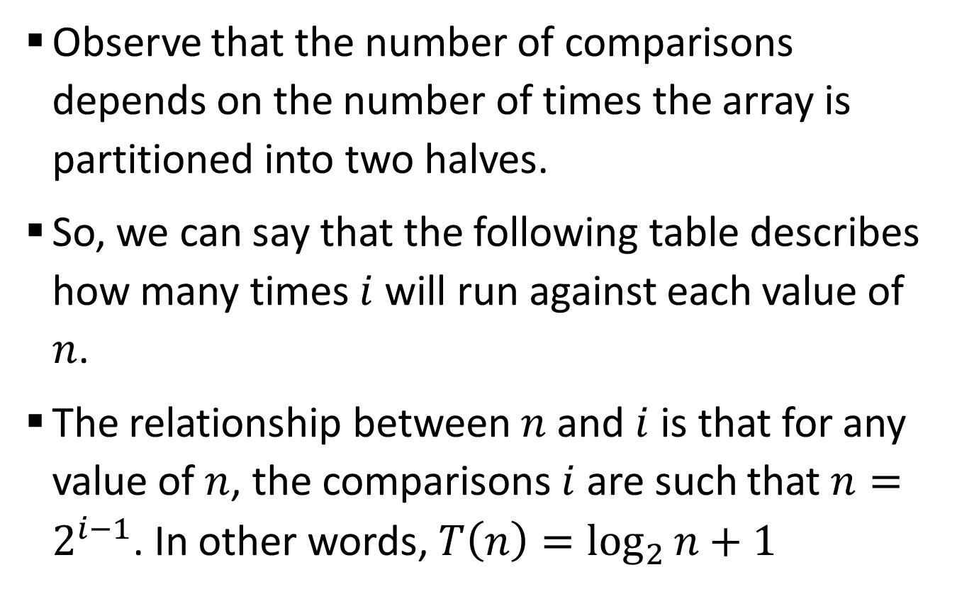
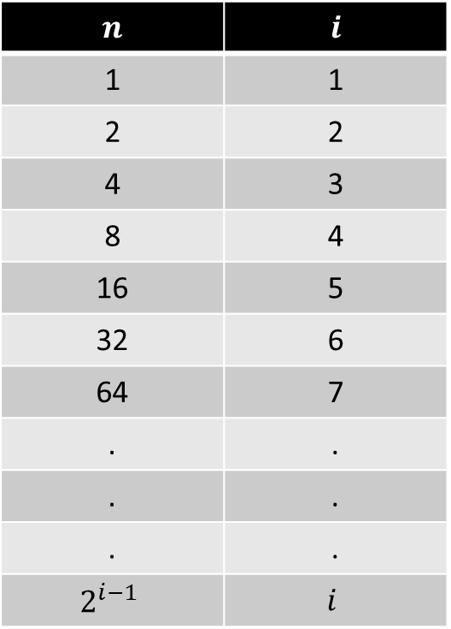
Sample 2
Complexity Analysis
Observe that the number of comparisons depends on the number of times the array is partitioned into two halves.
So, we can say that the following table describes how many times $i$ will run against each value of $n$.
The relationship between $n$ and $i$ is that for any value of $n$, the comparisons $i$ are such that $n=2^{i−1}$. In other words, $T\left(n\right)=\log_{2}{n}+1$
$$n$$ | $$i$$
1 | 1
2 | 2
4 | 3
8 | 4
16 | 5
32 | 6
64 | 7
. | .
. | .
. | .
$$2^{i−1}$$ | $$i$$

Slide 21



THANK YOU
Owais Hussain
+92 345-3174270
owais.hussain@kiet.edu.pk
https://www.researchgate.net/profile/Owais-Hussain-3

